Slide 1
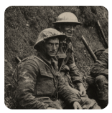
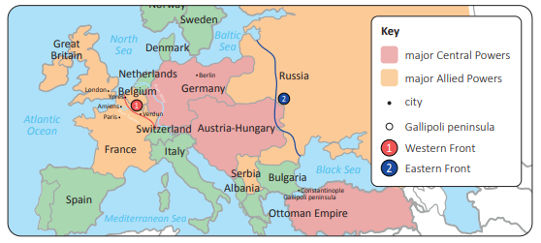
In the Britain at War project, your child will learn about the causes, events and consequences of the First and Second World Wars, the influences of new inventions on warfare, how life in Great Britain was affected and the legacy of the wars in the post-war period.
We will also be developing an understanding of the ‘Make Do and Mend’ campaign on everyday life during and after the Second World War.
Britain at War

Slide 2
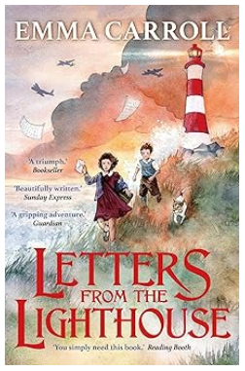
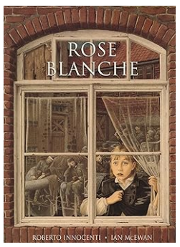
This term, our whole class books are ‘Letters From the Lighthouse’ by Emma Carroll and ‘Rose Blanche’ by Roberto Innocenti and Ian McEwan
In February 1941, after months of London bombings, twelve-year-old Olive Bradshaw and her brother Cliff are evacuated to the Devon coast. The only available shelter is with Mr. Ephraim, a reclusive lighthouse keeper who resents their presence.
Rose Blanche, named after a German resistance group, witnesses the unsettling changes in her town as soldiers fill the streets. She follows a truck carrying a captured boy to a hidden camp of starving children behind barbed wire. Secretly, she brings them food until soldiers in new uniforms arrive, and Rose and the children vanish forever.

